Slide 1
Traffic Signs Recognition using CNN and Keras in Python
Week – 5 Day - 3

Slide 2
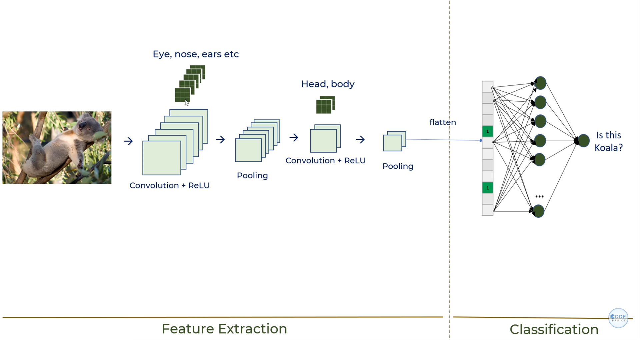
What is CNN
In machine learning, a Convolutional Neural Network (CNN) is a type of deep learning model particularly well-suited for analyzing visual data like images and videos.
Parts of CNN
Feature extraction
Classification

Slide 3
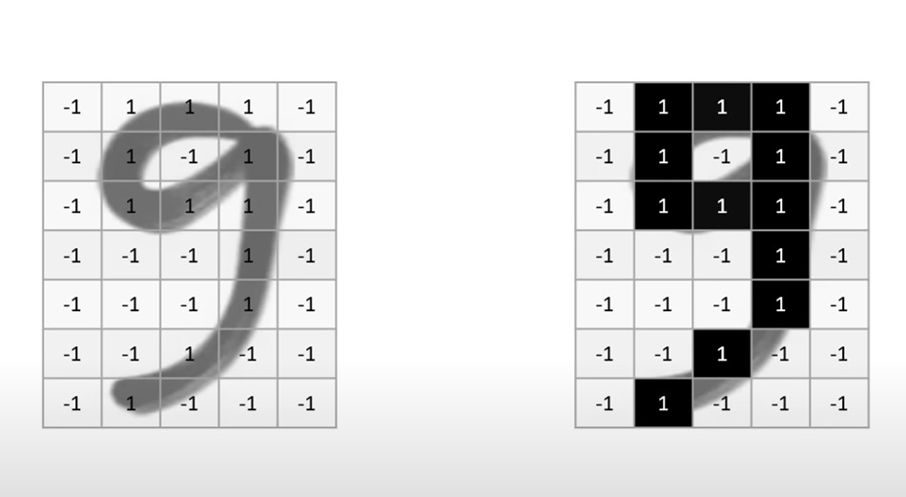

Let's take yesterday example, Handwritten digits

Slide 4
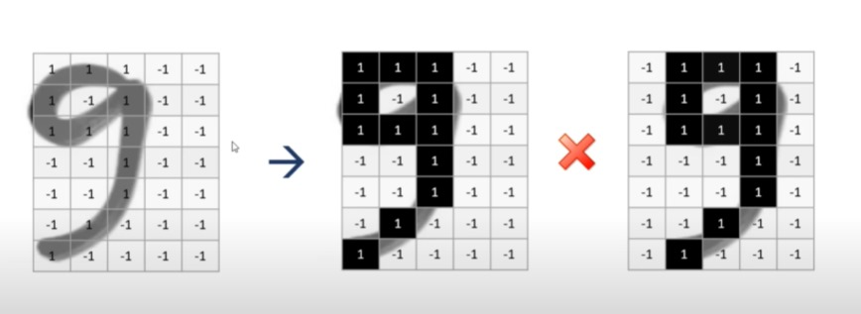
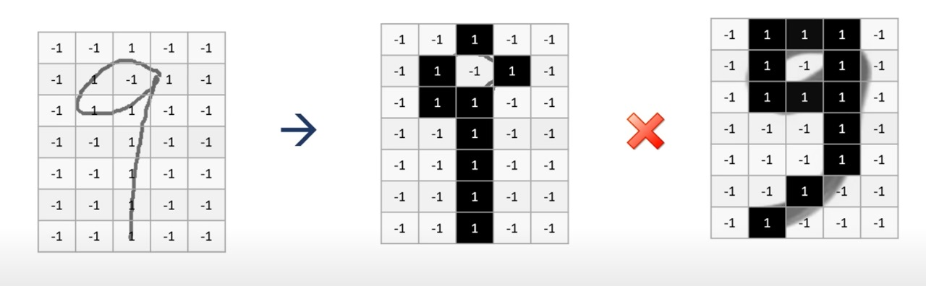
Location shift
Different Image

Slide 5
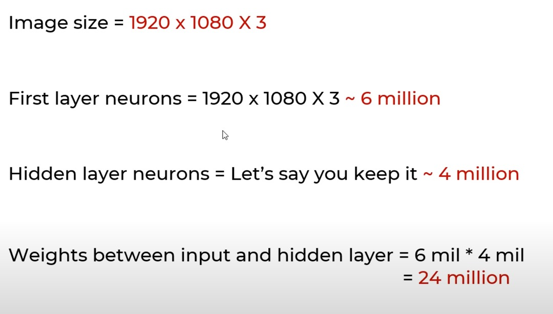
In ANN it is difficult to feed high resolution images so, we use CNN

Slide 6
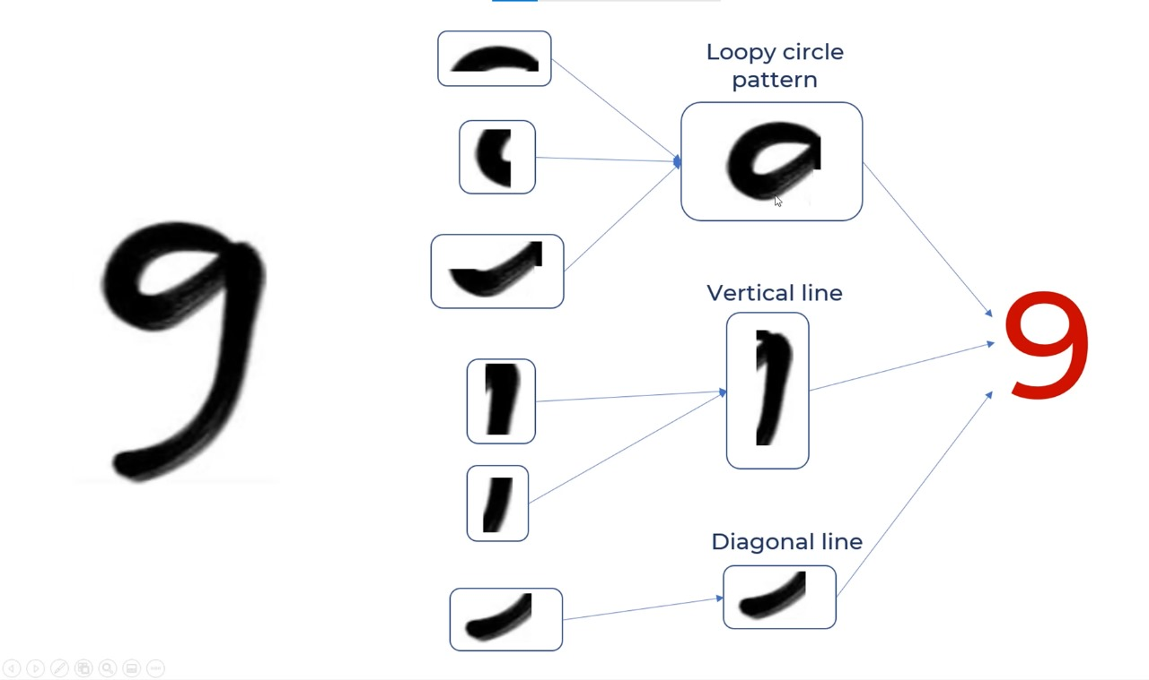
This is how our human brain understand that this digit is 9
but how can we make computers recognize these tiny features

Slide 7
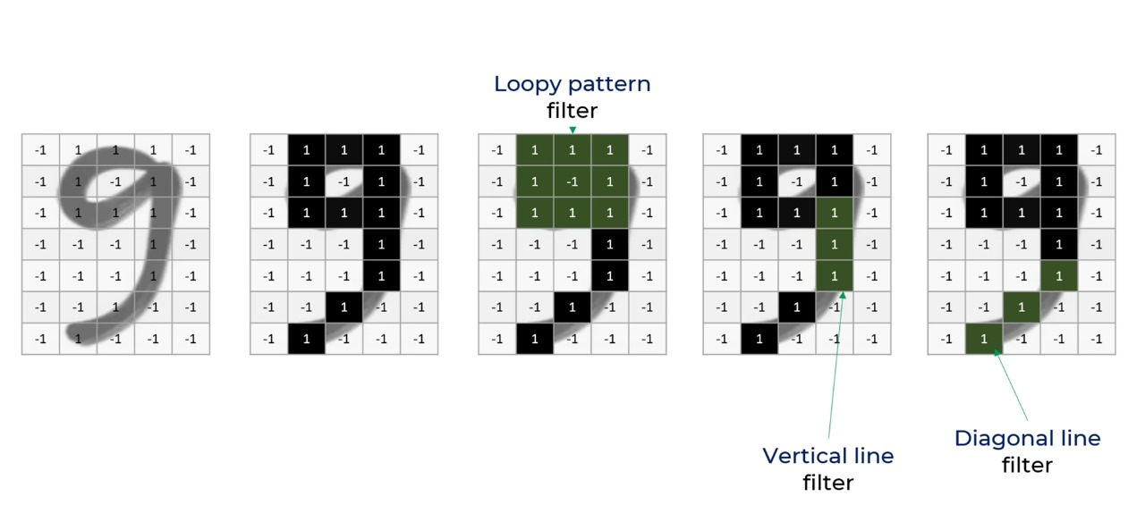
Here comes CNN into action we consider three filters to figure out digit 9

Slide 8
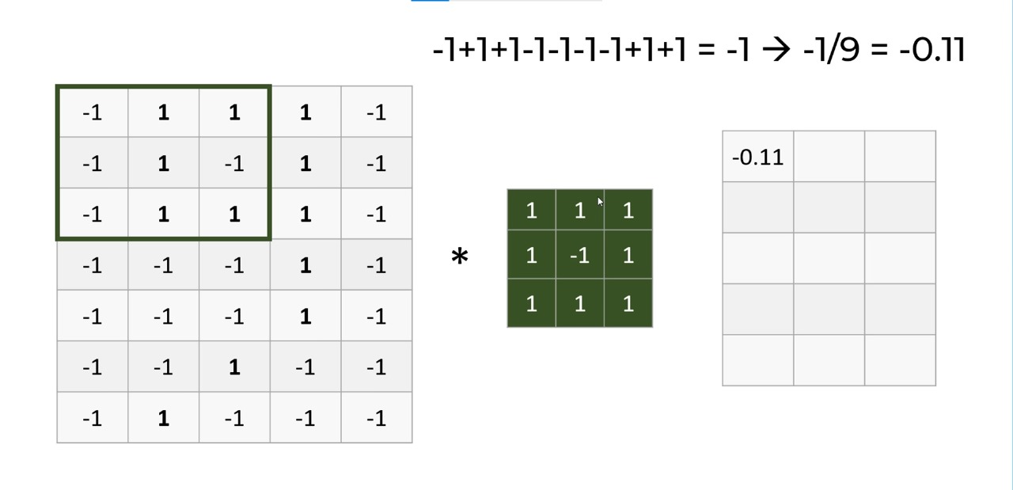
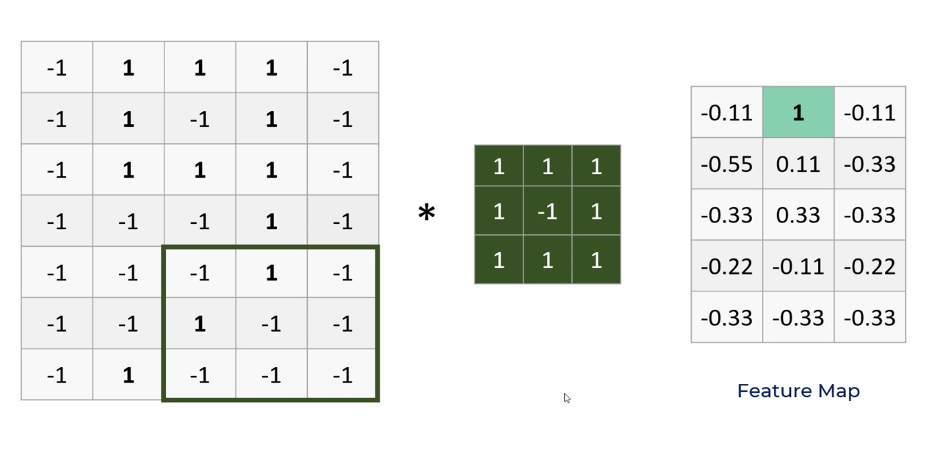
This is how feature extraction starts

Slide 9
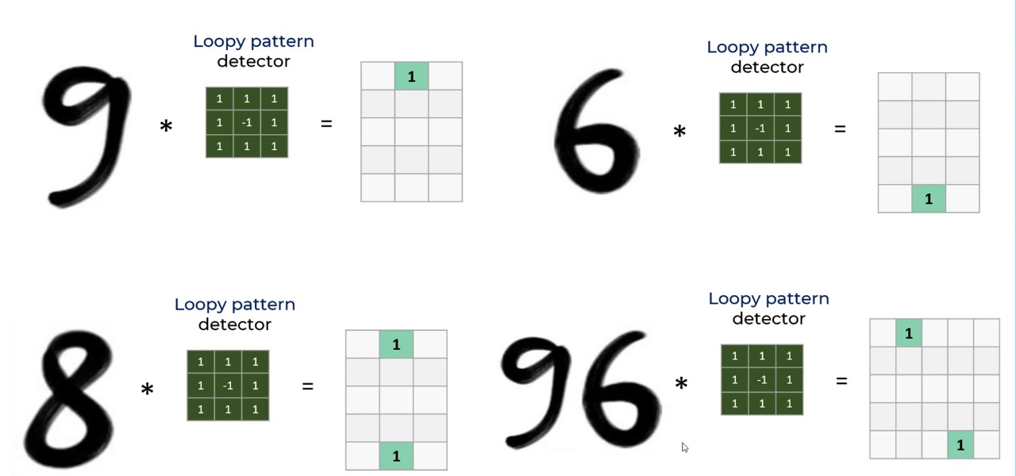
For different digits it works differently based on location

Slide 10
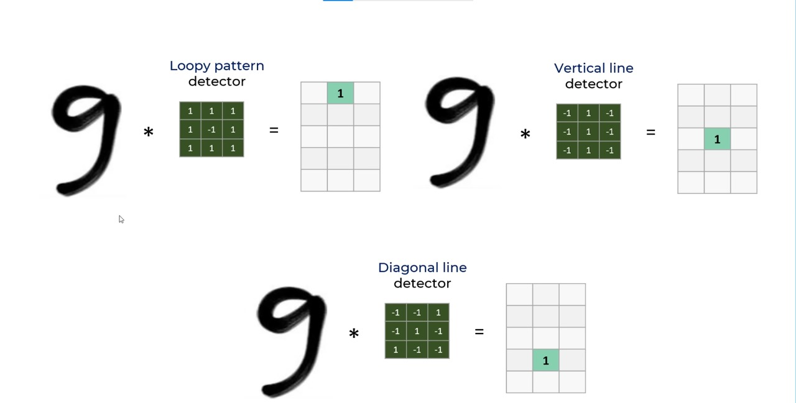
After applying all three filters we get out like this

Slide 11
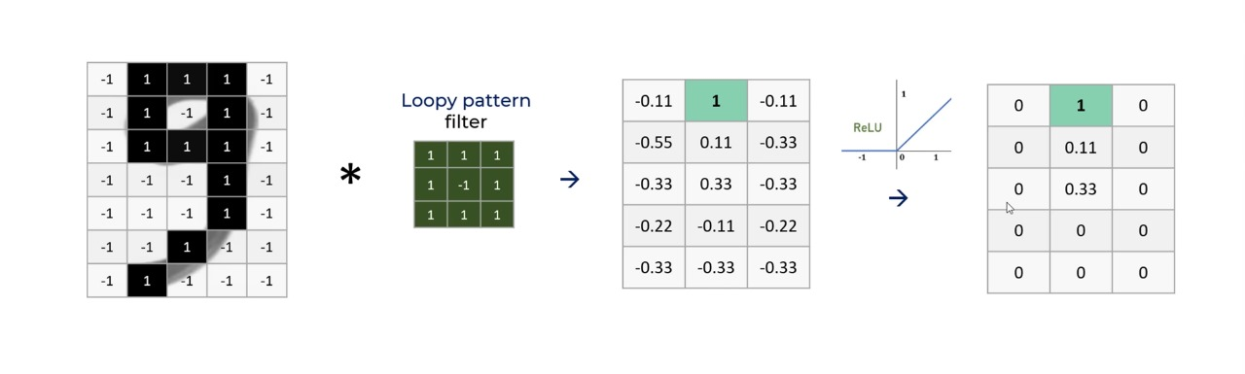
Application activation function [RELU]

Slide 12
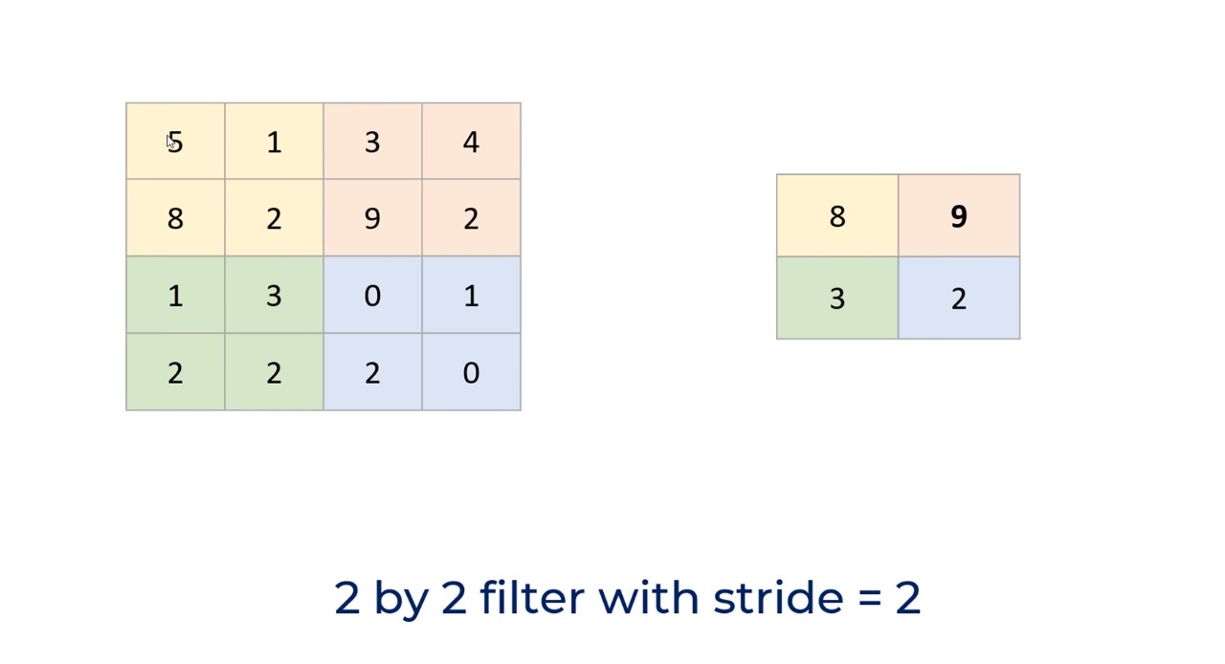
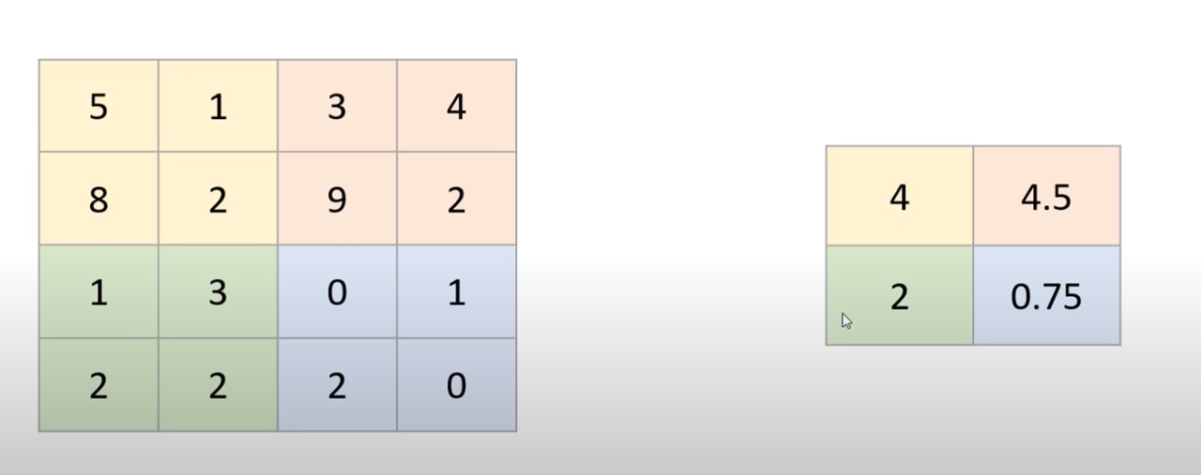
The main goal of CNN is to decrease the resolution with maximum feature extraction Till now we have extracted features We use pooling to decrease the resolution There are two types of pooling Max Pooling Average Pooling

Slide 13
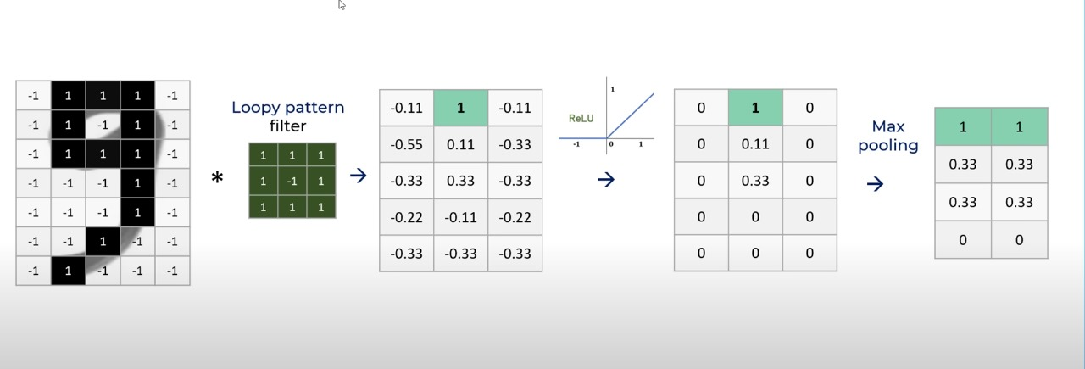
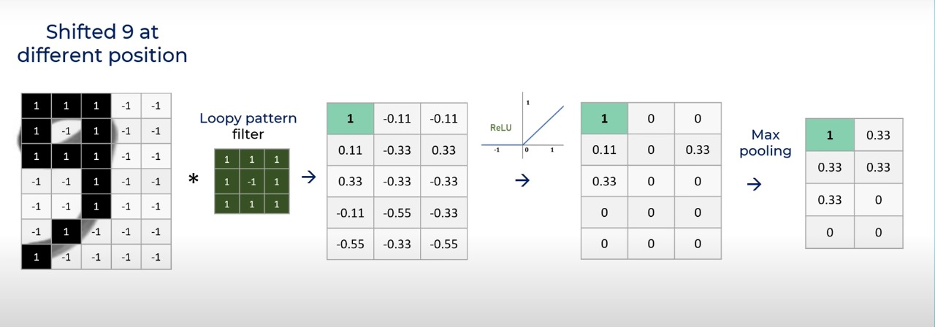

Slide 14
